Slide 1
ThalaMitra-AI Donar Matching & Engagement(MVP)
"ThalaMitra – AI that connects hearts through blood"

Slide 2
Problem Statement:
Regular transfusions needed for Thalassemia patients
Shortage of rare blood groups
Lack of predictive donor management
Last-minute panic in rural areas

Slide 3
Solution Overview:-
AI-based donor–patient matching
Predictive donor availability
Integration with e-RaktKosh & hospitals
Gamified donor engagement & rewards

Slide 4
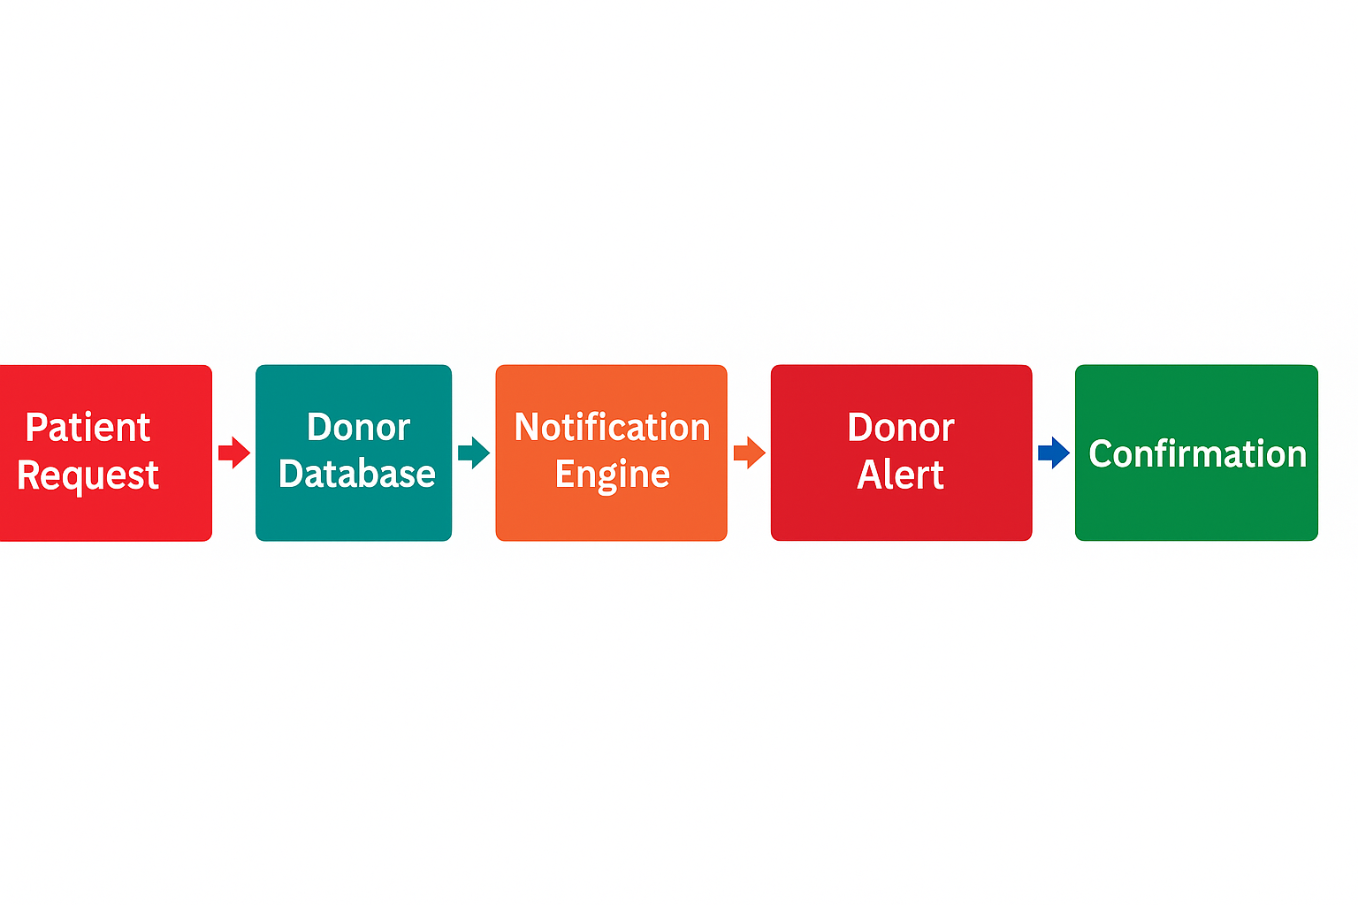
Architecture Diagram:-
Blocks: Patient Request → AI Matcher → Donor Database → Notification Engine → Donor Alert → Blood Bank Coordination → Confirmation

Slide 5
Key Features:-
Donor eligibility checker
Top donor ranking & badges
WhatsApp/SMS alerts
Offline “ThalaMitra Boxes” for rural requests
Social media campaigns

Slide 6
Tech Stack:-
Frontend: Streamlit (Web MVP)
Backend: Python + scikit-learn (ML model)
Database: CSV (scalable to PostgreSQL/MongoDB)
APIs: Google Maps, WhatsApp, e-RaktKosh
Hosting: Streamlit Cloud / AWS

Slide 7
Impact:-
Faster matching → timely care
Donor motivation → higher retention
Rural outreach → inclusivity
Data-backed policy making

Slide 8
Challenges:-
Data privacy compliance
Initial donor adoption
Offline integration challenges

Slide 9
Roadmap:-
Now: MVP with prediction model
3 months: Pilot in 1 city + 2 rural districts
6 months: NGO integration (Blood Warriors)
12 months: National roll-out

Slide 10
Closing & Call to Action:-
“Together, let’s make sure no Thalassemia patient waits for blood.”

Slide 11
Thank You

